Slide 1
Healthcare Emergency Preparedness Coalition Exercises
Pat Anders and
Manager, Health Emergency Preparedness Exercises
Office of Health Emergency Preparedness

Slide 2
Informational Webinar

Slide 3
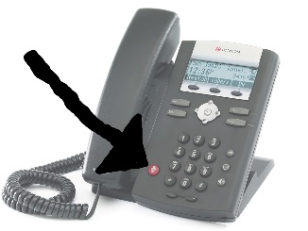
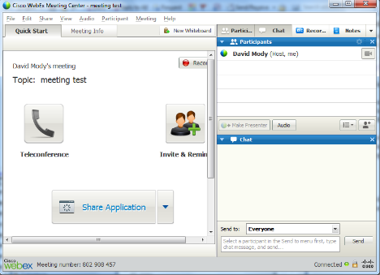
Reminders
Please mute your phone line when not speaking to reduce background noise.
Please hold questions for the presenter until the end of the presentation.
Please use the chat box to ask questions at anytime during the webinar, and we will respond at the end of each presentation.
Please do not put the conference call on hold!
Please do not close your web browser, as you may have difficulty returning to the presentation

Slide 4
Briefing Objectives
Understand the capabilities and the objectives of the three exercises
Understand the integration of the three exercises

Slide 5
Capabilities To Be Tested

Slide 6
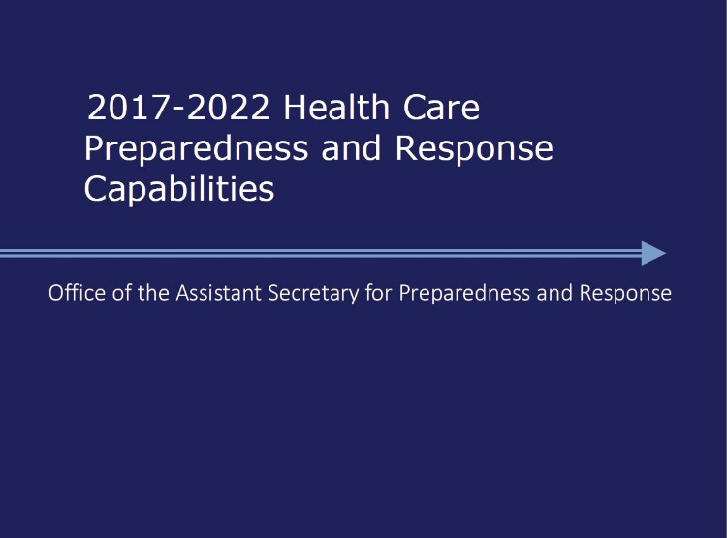
Capabilities
Coalition Surge Test
Foundation for Health Care and Medical Readiness
Health Care and Medical Response Coordination
Continuity of Health Care Service Delivery
Medical Surge
Medical Countermeasure 3-of-3 Drills
Medical Materiel Management and Distribution Exercise
Interoperable Communications Drills
Information Sharing

Slide 7
Overview of Required Exercises

Slide 8
Exercise Overview
Conduct an annual Coalition Surge Test (CST) that:
Tests functional surge capacity and identifies gaps in surge planning
Tests ability to perform the tasks with existing on-site staff without excessive guidance or prompting
Tests if evacuating facility knows who to contact in evacuation scenario, and ability to reach partners on a moment’s notice

Slide 9
Exercise Overview
Conduct two (2) annual Interoperable Communications Drills that:
Helps Health Emergency Preparedness Coalitions (HEPC) partners ensure that they have redundant forms of communication among their members.
Refers to having multiple back-up communication modalities, and is critical to emergency preparedness planning.
Cell phones, satellite phones, HAM radios, VOIP, HCS

Slide 10
Exercise Overview
Conduct an annual public health and medical preparedness exercise (Medical Countermeasures Drills) that:
Specifically addresses the needs of people with disabilities and other at-risk individuals or populations, and
Report in the following year’s funding application on the strengths and weaknesses identified and corrective actions taken to address weaknesses.

Slide 11
Exercise Overview
Activities a the region or sub-regional level allow a “stress” on other systems, such as the NYSDOH Regional Office
Identify gaps or communication needs
Allows for focused inclusion of other coalition partners (Health Emergency Preparedness Coalition)
Facilitates the completion of other grant requirements
Can help partners meet CMS requirements

Slide 12
Coalition Surge Test
Coalition Surge Test
An Exercise for Assessing and Improving Health Care Coalition Readiness
HANDBOOK FOR PEER ASSESSORS AND TRUSTED INSIDER
JANUARY 2017
Page 1 of 16

Slide 13
Coalition Surge Test - Final Objectives
Evacuating Hospitals
Activate Hospital Command Center
Assess patients needing to be evacuated
Long-term Care;
Pediatrics;
Behavioral;
Medical-Surgical;
Labor and Delivery;
Intensive Care Unit;
Neonatal Intensive Care Unit
Priority patient types

Slide 14
Coalition Surge Test - Final Objectives
Evacuating Hospitals
Assess which patients can be decompressed
Discharged home
Discharged home with home care
Discharged/admitted to a nursing home
Transferred to a receiving facility
Contact hospitals regionally to determine appropriate staffed, acute care bed match
Contact transportation providers to determine available assets

Slide 15
Coalition Surge Test - Final Objectives
Evacuating Hospitals
Participate in the Coalition Surge Test (CST) facilitated discussion at the end of the exercise to discuss transportation planning, ensuring the capacity of facilities, patient tracking, public information, needs of at-risk patients, and continuity of operations.

Slide 16
Coalition Surge Test - Final Objectives
Receiving Hospitals
Assess current patient census
Determine number of available beds for evacuating patients from other facilities
Assess which patients can be decompressed to free up additional beds
Discharged home
Discharged home with home care
Discharged/admitted to a nursing home

Slide 17
Coalition Surge Test - Final Objectives
Receiving Hospitals
Respond to calls from evacuating facilities to determine if an appropriate staffed, acute care bed is available
Confirm patient “placement” via call with evacuating facilities

Slide 18
Coalition Surge Test - Final Objectives
Receiving Hospitals
Participate in the Coalition Surge Test (CST) facilitated discussion at the end of the exercise to discuss transportation planning, ensuring the capacity of facilities, patient tracking, public information, needs of at-risk patients, and continuity of operations.

Slide 19
Coalition Surge Test - Final Objectives
Health Emergency Preparedness Coalitions (HEPCs)
Demonstrate resource support and coordination among healthcare facilities.
Demonstrate the ability to use a primary and back-up communication system (internet – includes VOIP, radio, cellular, and satellite) to communicate with coalition partners (LHD, hospitals, Emergency Medical Services, Emergency Managers, or other partners) within 90 minutes of start of the exercise.

Slide 20
Coalition Surge Test - Final Objectives
Health Emergency Preparedness Coalitions (HEPCs)
Conduct the Coalition Surge Test (CST) facilitated discussion at the end of the exercise to discuss transportation planning, ensuring the capacity of facilities, patient tracking, public information, needs of at-risk patients, and continuity of operations.
Participate in the Executive Staff After-Action Review conducted by the acute care Healthcare Associations and the HEPC Leads within 30 days of completion of the Coalition Surge Test.

Slide 21
Medical Countermeasure 3-of-3 Drills

Slide 22
Medical Countermeasure 3-of-3 Drills -Final Objectives
LHD notifies and confirms availability of pre-identified County Staging Sites (CSS) within one hour of the decision to activate.
LHD notifies required CSS personnel within one hour of the decision to activate the CSS.
LHD notifies all available personnel identified to fill role for the first operational period within two hours of decision to activate CSS, or within one hour of initial staffing notification.

Slide 23
Medical Countermeasure 3-of-3 Drills -Final Objectives
All identified CSS staff for first operational period report to CSS within one hour of confirmed staffing request.
LHD sets up CSS within six hours of decision to activate.

Slide 24
Interoperable Communications

Slide 25
Interoperable Communications Drills - Final Objectives
Demonstrate the ability to use a primary and back-up communications system (internet – including VOIP, radio, cellular, and satellite phone) to communicate with coalition partners (LHD, hospitals, EMS, EM, and other partners).
Complete the NYSDOH Health Commerce System (HCS) Health Emergency Response Data System (HERDS) survey within the timeframe outlined in the IHANS alert.

Slide 26
Information Sharing for Situational Awareness (IOC Drill #2)
RO
Local Health Departments
Other HEPC Partners

Slide 27
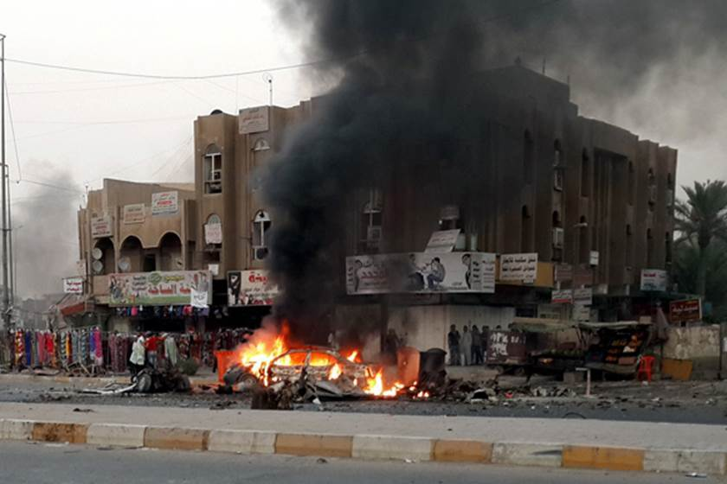
Exercise Scenarios
Diverse scenarios across regions for
Coalition Surge Test
Credible threats of anthrax release by same terrorist organization are confirmed through laboratory testing
Local Health Departments are directed to activate County Staging Sites (CSSs) to receive antibiotic assets for Points of Dispensing to prophylax the public

Slide 28
Exercise Participants
Local health departments
Hospitals
Home Care
Nursing Homes
Community Health Centers
Adult Care Facilities
Hospice
Emergency Managers
EMS

Slide 29
Exercise Schedule
MCM/IOC exercise dates and times: Regionally determined
Central New York February 27, 2019
Western New York April 4, 2019
Capital District April 11, 2019
Long Island April 18, 2019
Lower Hudson Valley May 9, 2019

Slide 30
Exercise Conduct

Slide 31
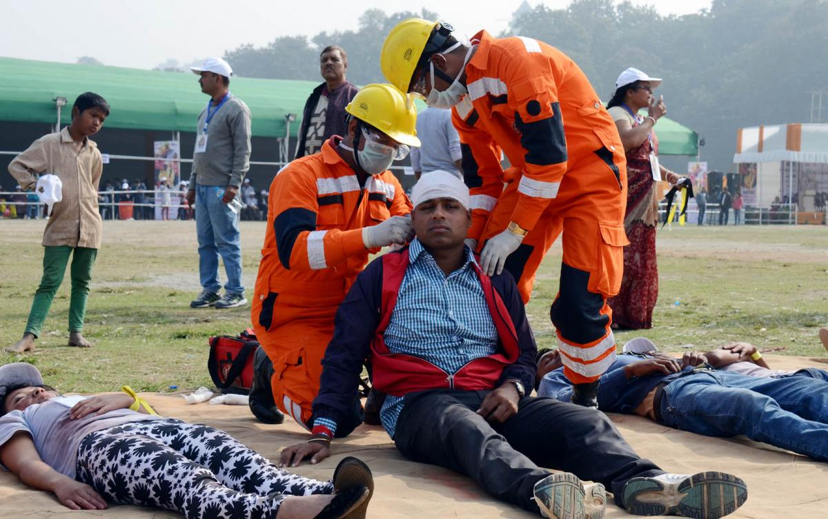
Exercise Roles
Controller
Evaluator
Player/Participant
Observers (optional)

Slide 32
IOC Exercise Algorithm
STARTEX
NYSDOH Regional Offices send IHANS alert to coalition members via phone, text, and email, directing partners to HERDS survey on HCS with name of drill survey (IOC Drill).
Phone and text alerts will direct partners to check their emails.
LHDs will be alerted via same modalities.
Email alert will direct all healthcare providers to complete HERDS survey by close of business.
If coalition members do not have access to HCS, ROs determine different mechanism to get message out.
Any problems completing the IHANS alert, call RO IHANS IT for support.

Slide 33
Final Reminders
Safety comes first. Use the phrase “real-world emergency” when an emergency occurs
Know your role and responsibilities
Understand the scenario
Do not prompt or get in the way of players
Contact the Regional Office with any problems or questions

Slide 34
Questions? Pat Anders patricia.anders@health.ny.gov

